Slide 1
ENSE 477
Scrum Report-Out
t2ee
Zuoxiu Xing
2020/02/25

Slide 2

Project deats
Remind me what you are doing
  Web portal that utilizes OpenStack API and services
  Self-service VM deployment platform
Notes:
I am trying to make a self-service virtual machine deployment platform which is a web portal that utilize openstack api and services

Slide 3

Progress review
How did you address previous scrum comments?
  Documents
  Coding
Notes:
The main comment from previous scrum is document. And I have pretty much finished coding for now.

Slide 4
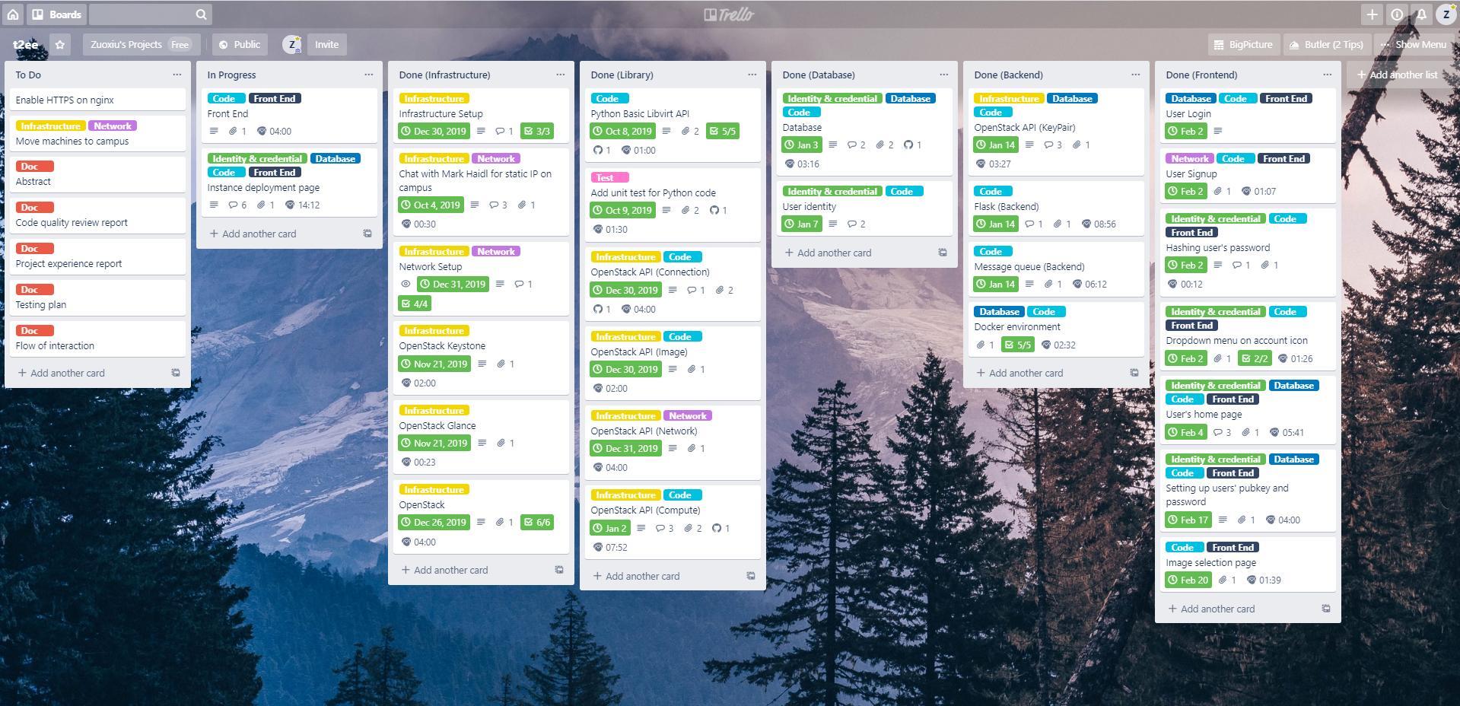
Trello
Notes:
Here is my trello board

Slide 5
Documents
Requirement documents
Architectural Design
Notes:
I have been working on these two documents and coding during the winter break and made good progress

Slide 6
Demo
http://docker.hzyone.com:6001/

Slide 7

Group reflection
Do you feel you are on track?
  Yes
Do you feel there are barriers to your success (if any)?
  Documents
Do you need any help going forward?
  All good for now
Any other questions or concerns?
  Documents
Notes:
Test plan on syllabus
Developing in marking rubric

Slide 8
Image refs
Show me what you got, https://pictures.abebooks.com/isbn/9781548899530-us-300.jpg
Patrick, https://imgflip.com/memetemplate/43274976/spongebob-patrick-nail-saw
Dilbert, http://4.bp.blogspot.com/-tVbJsudDNaw/T29WxQ0PHZI/AAAAAAAAABc/UlTwD2gkzA4/s1600/Dilbert%2520Software%2520Demo%5B1%5D.jpg
Pondering, https://imgflip.com/s/meme/Question-Rage-Face.jpg

